Slide 1
Top Down Dungeon Crawler
Into the Pit
Eric Grant

Slide 2
Gameplay
Overworld
Move with wasd
Interact with environment using menu options
Look for the exit
Avoid or engage enemies
Combat
Lose movement ability
Attack by using items in your inventory
Defeat enemies to gain XP
Use other consumable items to give yourself and advantage

Slide 3
Order of Operations
Wait for player input
Process input
Randomly decide on enemy actions
Process enemy actions
Repeat

Slide 4
Controller
Console View
Structure
Classes
Items
List of Enemies
World
Text
Map
Menu
Player
Console Utilities

Slide 5
Live Game Demo

Slide 6
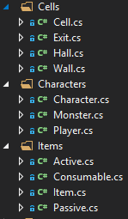
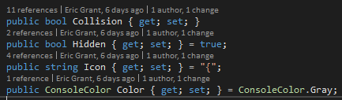
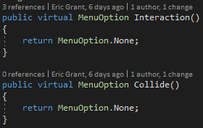
Abstraction

Slide 7
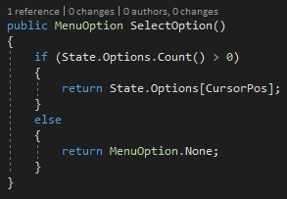
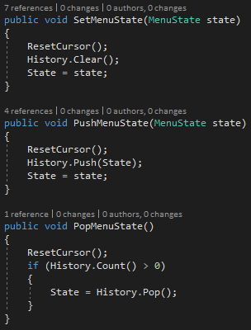
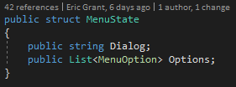
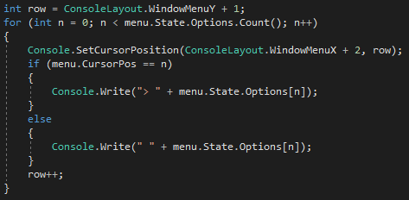
Menu

Slide 8
Map & Movement Logic

Slide 9
Importance of Scope & Infrastructure

Slide 10
Questions?

